Slide 1

Programming 6G4Z0020
Introduction to Java programming
Notes:
Dr David McLean – lecturer and researcher (google scholar) and programming for a long time – professionally and as an academic

Slide 2

Important Unit Information
Assessment :
Test (50%) : MCQ & coded
2D Game 50% : Classes
11 taught weeks
6 Java Processing, 5 Java Console
Each Week:
Webinar (1hr) : code a long
Lecture (1hr)
Lab 3hrs
Drop-in support lab (1 hour)
Webinar (1hr): code along with tutor
Graphical applications
Problem Solving
Console : textual applications
Best practice
Each topic is incremental – earlier concepts underpin the later concepts.
Learn programming and problem solving through Practice, Practice, Practice!!!
Notes:
Syllabus on moodle, Processing webpage contain tutorials covering all the fundamentals and more.
Learning resources for nature of code

Slide 3
Today’s Learning Objectives
1. Syntax and sequence of commands
2. Variables – storing data
3. Expressions
Notes:
Topics
Who’s coded before?
Procressing is Java commands with graphics – great type of applicaton to learn prpogrMMING
Can’t learn to program through reading a book or listening to lectures. Skill : Requires regular practice
Syntax is the structure of a language
Variables – algebra in Maths, manipulated through maths expressions

Slide 4
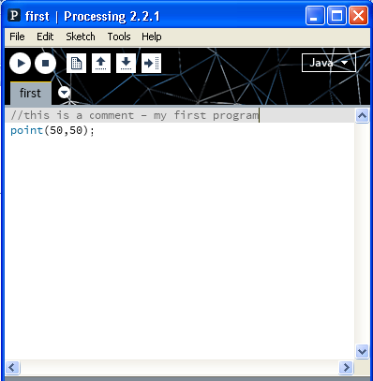
First Program
play
stop
Processing Development Environment
Sketch - program
Menu – save load etc.
Comment – ignored by computer, // at start
1 command ; at end
Draw a point on the screen
Where?
Notes:
Graphics applications
Comments we’ll use to state what we are doing and to help solve each problem

Slide 5
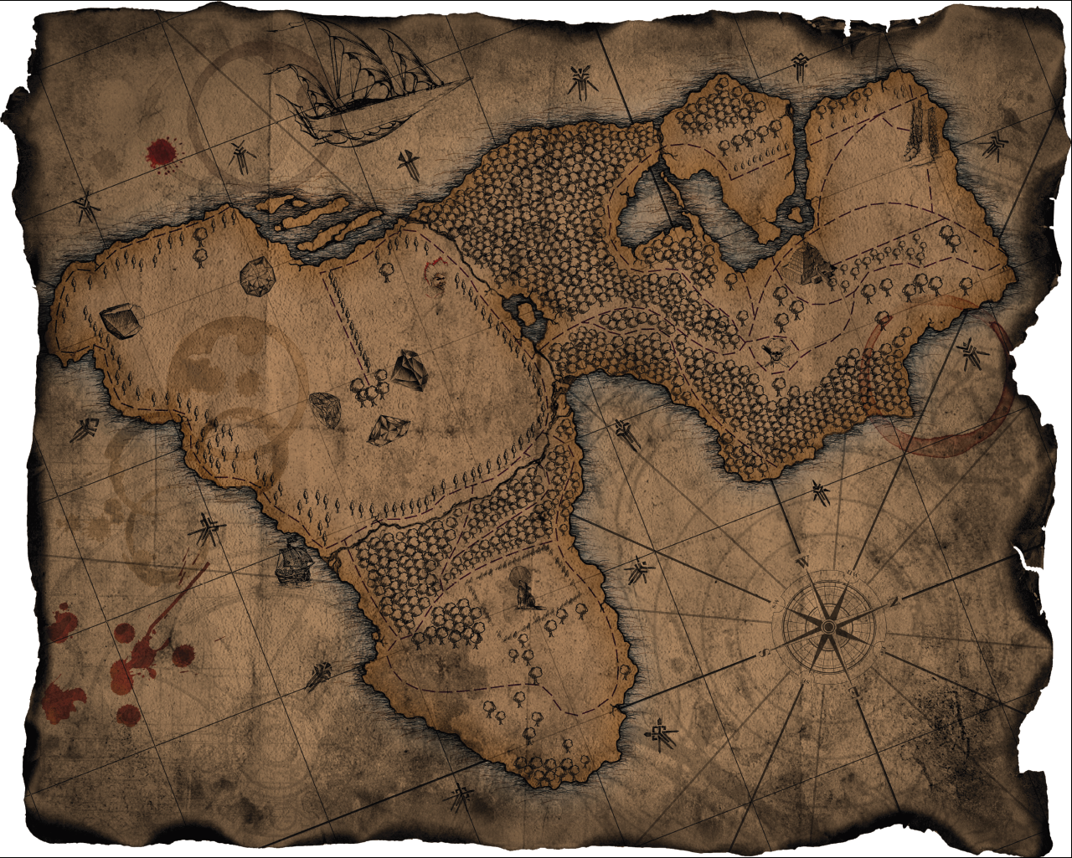
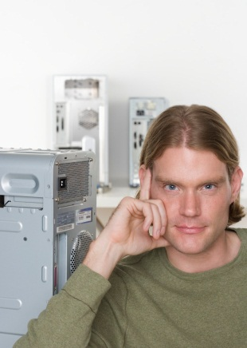

Computer Scientists can’t read maps
Y-axis
X=100
(50,25)
Y=0
X=0
X-axis

Slide 6


Computer Coordinates
X=0
X-axis
X=100
Y=0
(50,25)
Y-axis
always (x across, y down)
Y=100
Notes:
Swim across, sink down

Slide 7
Graphics (2D)
X axis : increasing X
origin
(0,0)
Y axis
increasing Y
Involves drawing on the screen
Draw a point at position 50 (X axis), 50 (Y axis)
Where would the following be:
point(50,10);
point(10,50);
point(0,0);
Notes:
0,0 – origin top left corner

Slide 8
Command arguments
Our drawing commands need information
Arguments (parameters) : information the command needs to work
What arguments did point need?
new command line(startX,startY, endX,endY) 4 arguments (2 pairs coords)
How would we draw a line along the left hand edge of the screen (origin, 50 pixels long?)
x, y pixel values
X axis : increasing X
origin
Y axis
y=50
increasing Y
Notes:
Leave a space between pairs
Origin (0.0) top left

Slide 9
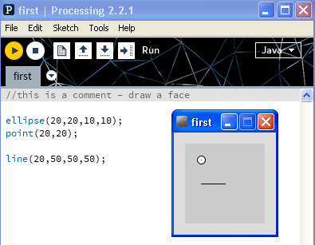
Drawing a face
ellipse(x, y, width, height)
Draws a circle, centre 20,20
diameter 10
point(x,y)
Draws a point at centre of circle
line(startX,startY,endX,endY)
Draws a line from 20,50 to 50,50
Commands performed in order top to bottom
Draw ellipse, then point, then line
Add commands to draw other eye
Use line to add a nose
Notes:
Ellipse syntax – what the arguments mean
Note mouth starts below centre of eye – same x, larger y value

Slide 10
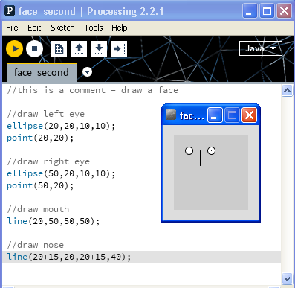
Order in programs
//right eye
point(50,20);
ellipse(50,20,10,10);
Point drawn over by ellipse – not visible.
Expression, forces the maths before performing the command
Notes:
Is that correct?
Expression – mouth is 30 pixels long, half is 15

Slide 11
Variables
Used to store values : numbers, words etc
Called variable because the value stored can change within the program
Many types but use: float & int for now
floating point number e.g. 10.5, 5.0, 1.765
int whole numbers e.g 5, 10, -56, 100
int x=10; //stores 10 in variable x
point(x,50);
Assign value 10 to box (variable)
called x
Using value stored in x
Where would point appear?

Slide 12
Variables & Expressions
picture a box in memory big enough to hold an integer number
An assignment, e.g. x = y + 30 means x assigned value in y + 30
int x,y;
x = 10;
x = x - 5;
x = x + 1;
y = 5;
x = x+3*y;
Expressions can use round brackets, and any arithmetic operators
/ Division operator % Remainder operator
(5+3+1)%2 equals 1
x
y
Notes:
X becomes equal to value stored in y + 30
Declare variables, boxes appear in memory with these names

Slide 13
Exercise (walk through)
Write a program to assign 3 integer values to 3 variables and find the average (mean) where A=10, B=15, C=25.
Notes:
Do together – walk through

Slide 14
Exercise
int x,y;
size(500,500); //set size of drawing window
background(0); //set background colour - black
stroke(255,255,255); //set outline colour R,G,B [0-255]
x=50;
y=20;
line(x ,y , x+20, y); //line draws from 1st pair parameters, to 2nd pair of parameters
line(x ,y , x, y+20);
What does code above do (draw result)?
Notes:
Using variables in graphics program

Slide 15
Draw a square (edge 50)
int x,y;
size(500,500);
x=50;
y=20;
line(x ,y , x+50, y);
line(x ,y , x, y+50);
line(x+50 ,y , x+50, y+50);
line(x ,y+50 , x+50, y+50);
How can we alter our code to easily draw squares of different edge size?
Use another variable?
Notes:
An example, code can be improved by using a variable – easier to understand what its doing.

Slide 16
Summary
What we’ve learnt so far
Sequence – program executes from top to bottom
Each line of program performs a command, ends in ;
Simple graphics commands:
Ellipse, point, line, size, stroke, background
Parameters – values (separated by ,) passed to commands
Variables store data
Met two types
float, int
Arithmetic operators and expressions
E.g. x=50/(100 + y)
Covering loops in the lab, which rely on variables!
Notes:
Loops in lab

